Slide 1
28.01.2025
Pascal

Slide 2
Test different input spectrum

Slide 3
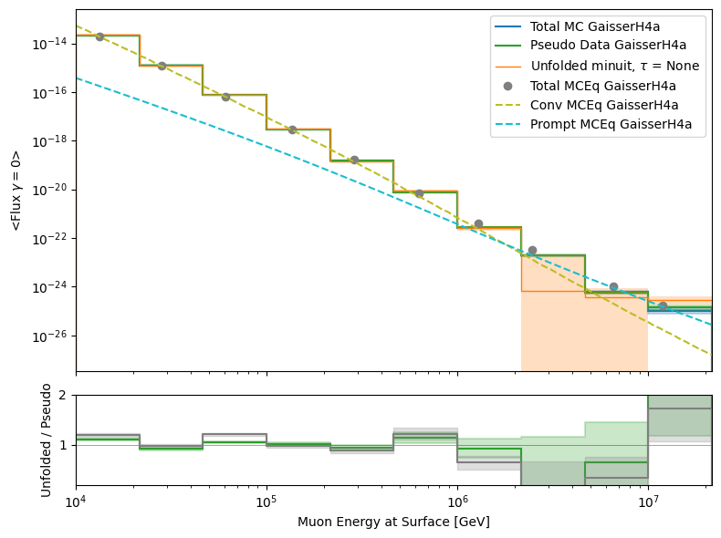
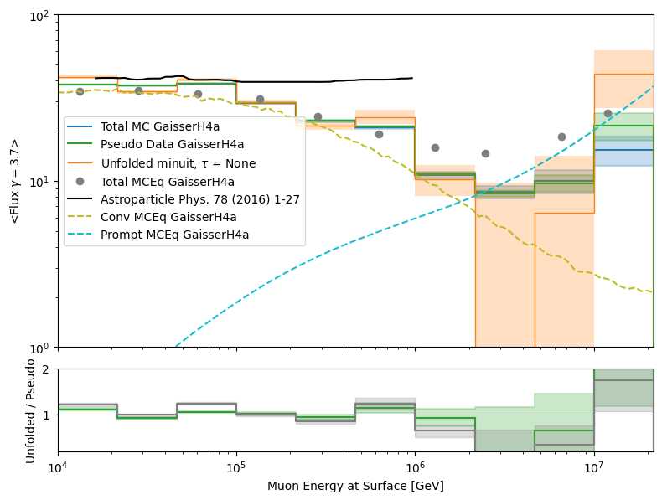
Unfolding with 5 systematics
x0 = [1e5, …, 1, 1, 1, 0.2, -0.05], bounds = [True values * 100 (/0.001),…, simulation bounds]

Slide 4
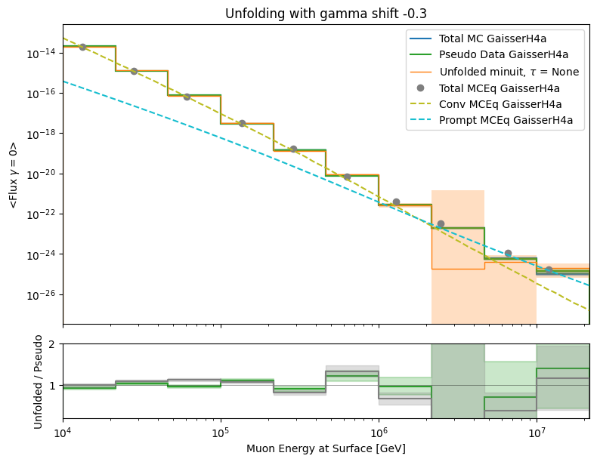
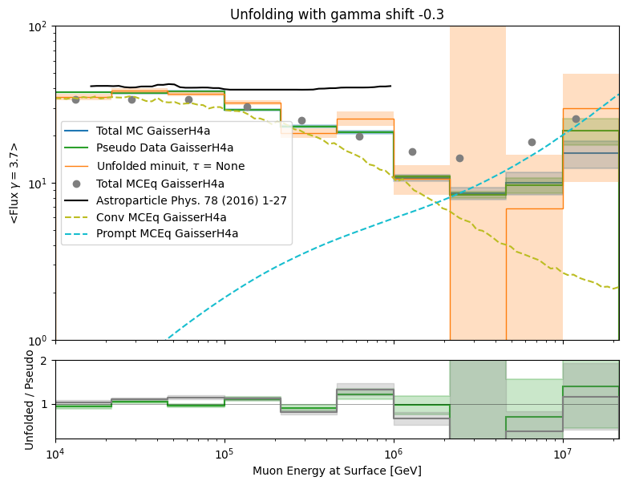
Unfolding with 5 systematics, gamma = -0.3
x0 = [1e5, …, 1, 1, 1, 0.2, -0.05], bounds = [True values * 100 (/0.001),…, simulation bounds]

Slide 5
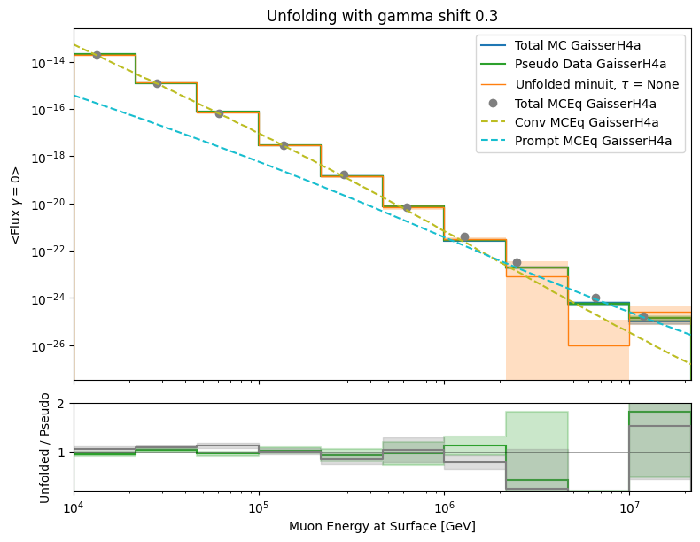
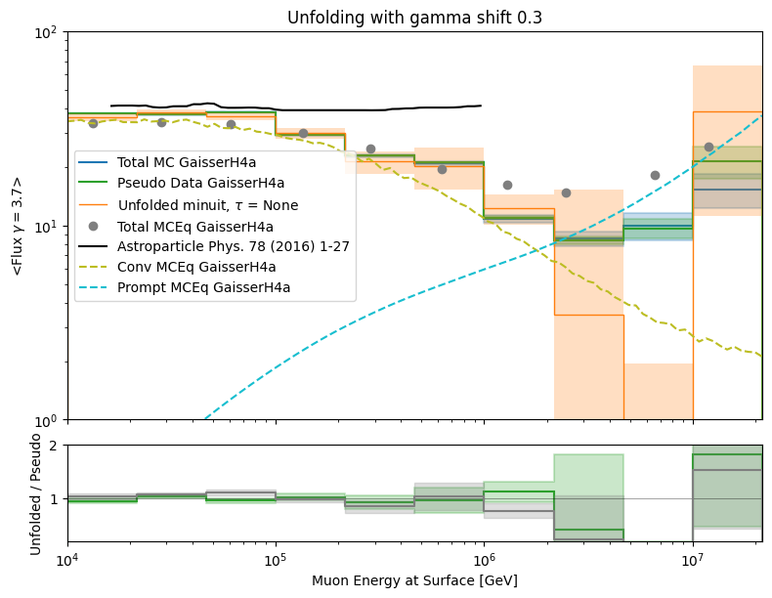
Unfolding with 5 systematics, gamma = +0.3
x0 = [1e5, …, 1, 1, 1, 0.2, -0.05], bounds = [True values * 100 (/0.001),…, simulation bounds]

Slide 6
Test different input spectrum with regularization
tau = 0.0001

Slide 7
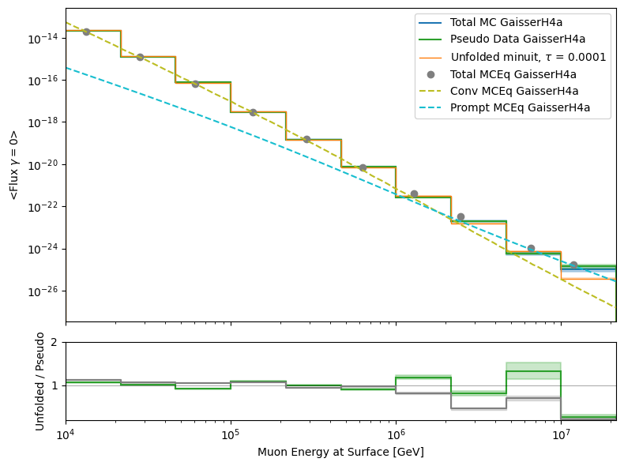
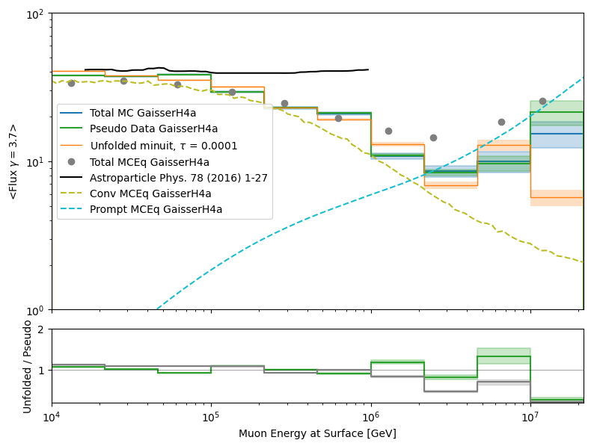
Unfolding with 5 systematics, tau = 0.0001
x0 = [1e5, …, 1, 1, 1, 0.2, -0.05], bounds = [True values * 100 (/0.001),…, simulation bounds]

Slide 8
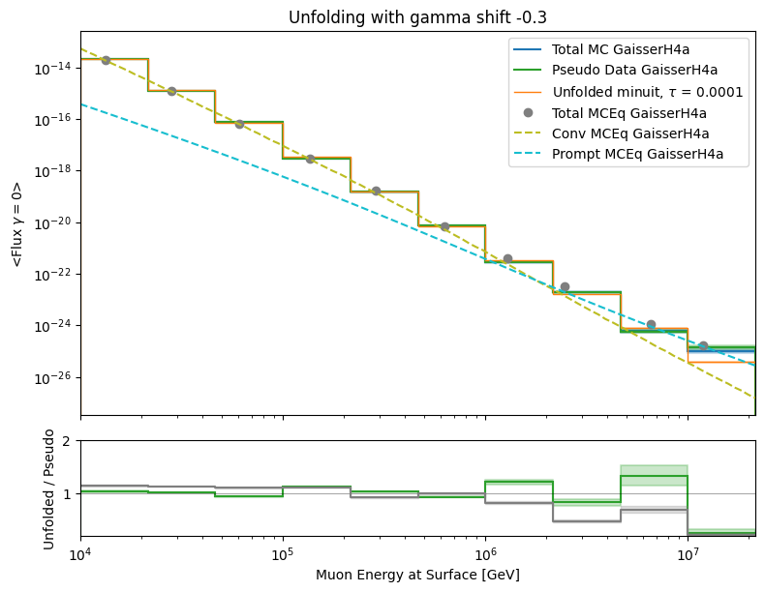
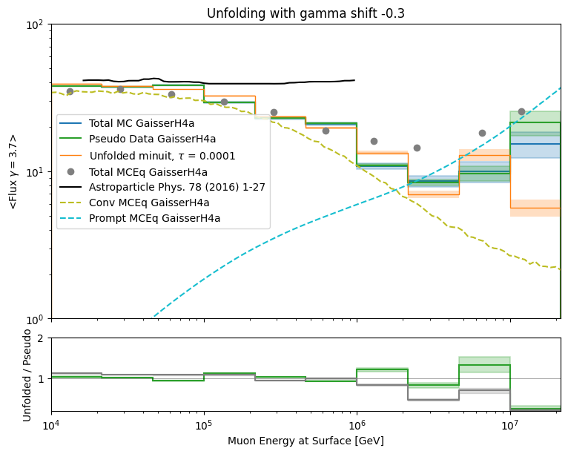
Unfolding with 5 systematics, gamma = -0.3, tau = 0.0001
x0 = [1e5, …, 1, 1, 1, 0.2, -0.05], bounds = [True values * 100 (/0.001),…, simulation bounds]

Slide 9
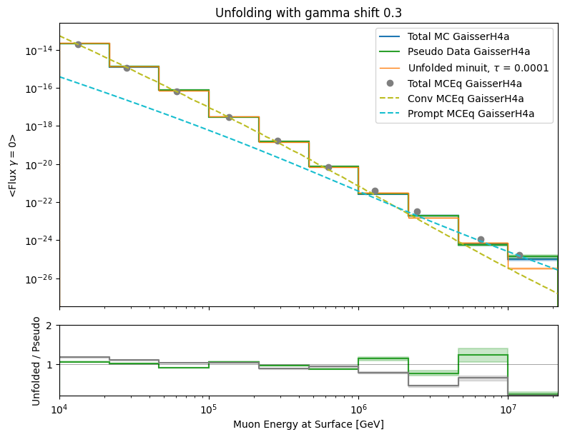
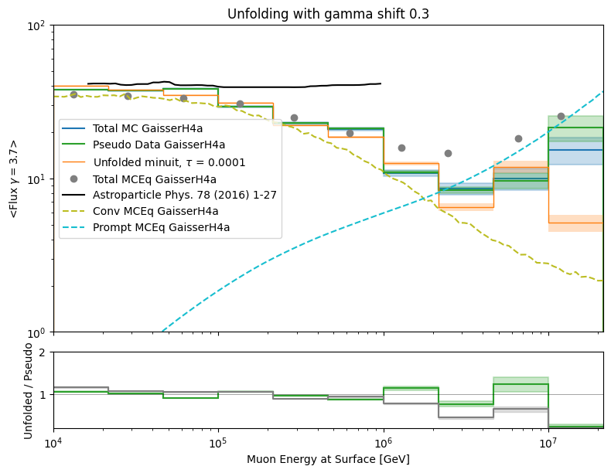
Unfolding with 5 systematics, gamma = +0.3, tau = 0.0001
x0 = [1e5, …, 1, 1, 1, 0.2, -0.05], bounds = [True values * 100 (/0.001),…, simulation bounds]

Slide 10
Train-Test-Split

Slide 11
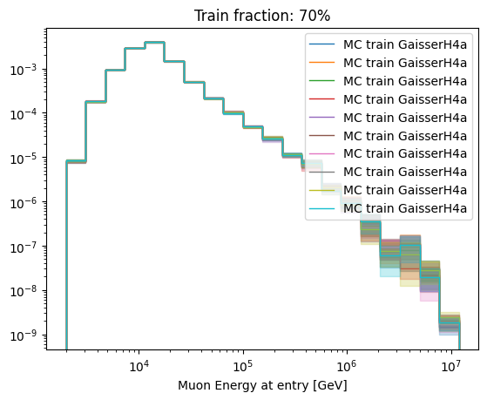
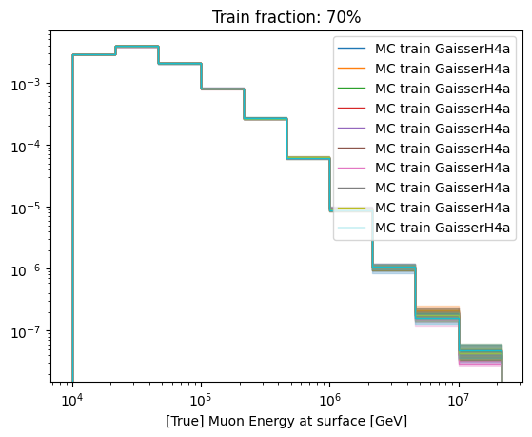
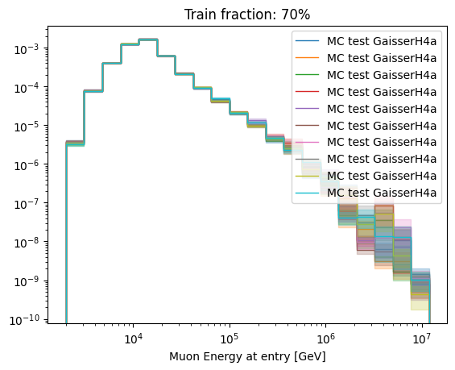
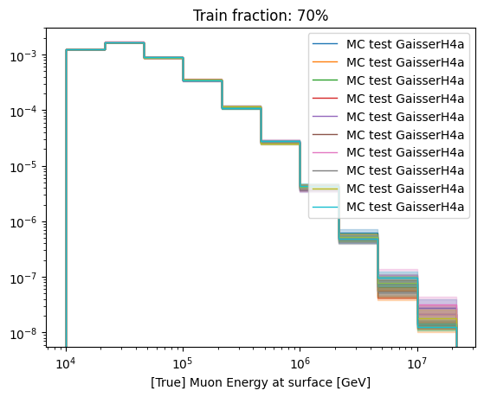

Slide 12
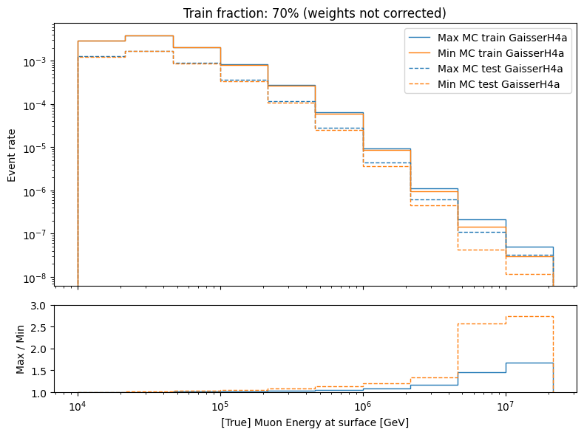
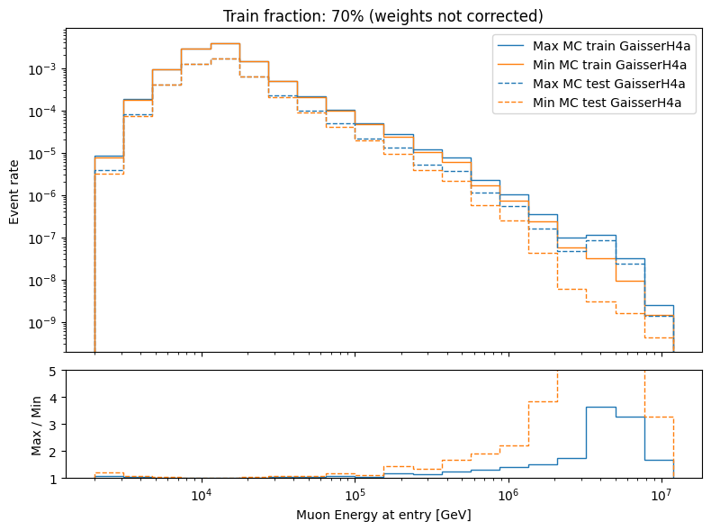
Plot min & max of train & test distribution after splitting
too less MC above ~1PeV muon energy at surface

Slide 13
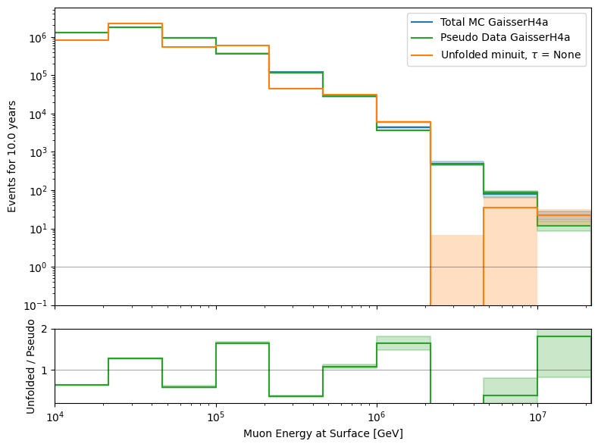
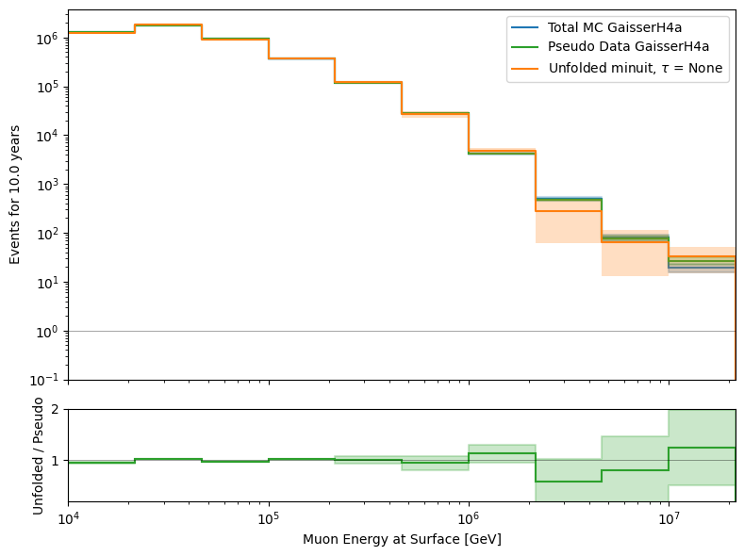
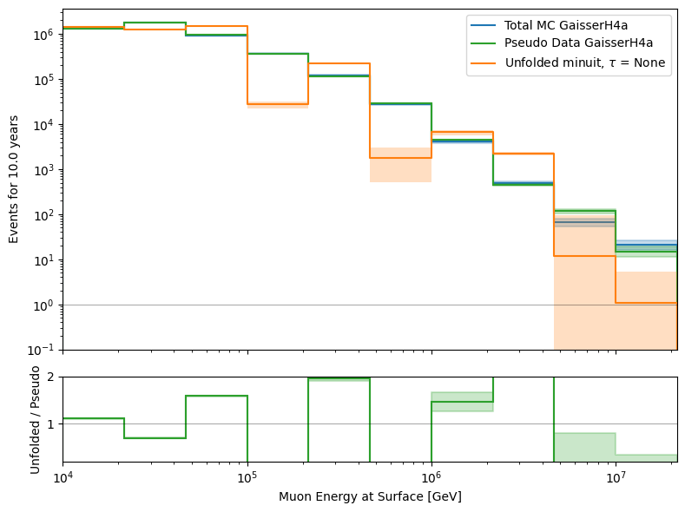
train fraction: 70%
Unfold event rate, not systematics
no train test split
run 1
run 2

Slide 14
Test prior

Slide 15


Gauss: scale=0.5 * (bounds[1] - bounds[0])

Slide 16
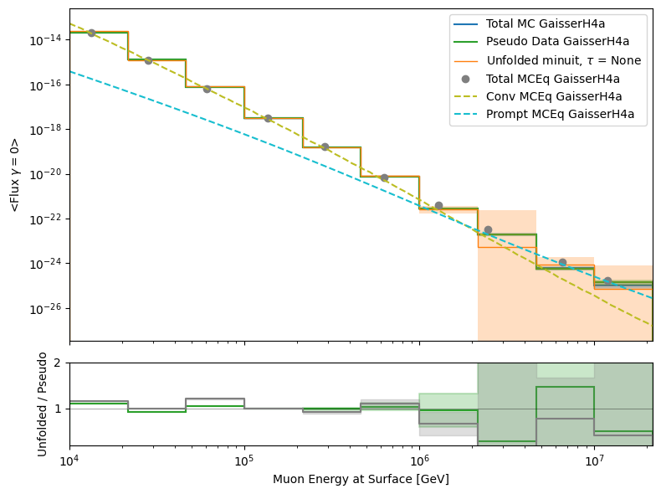
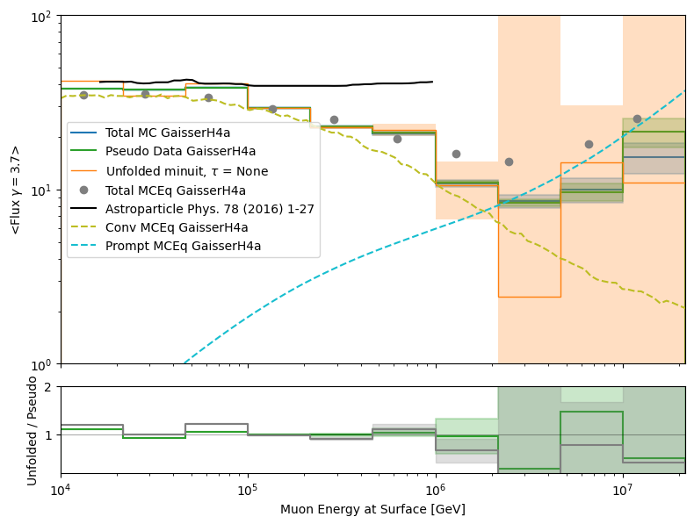
Gauss: scale=10 * (bounds[1] - bounds[0])

Slide 17
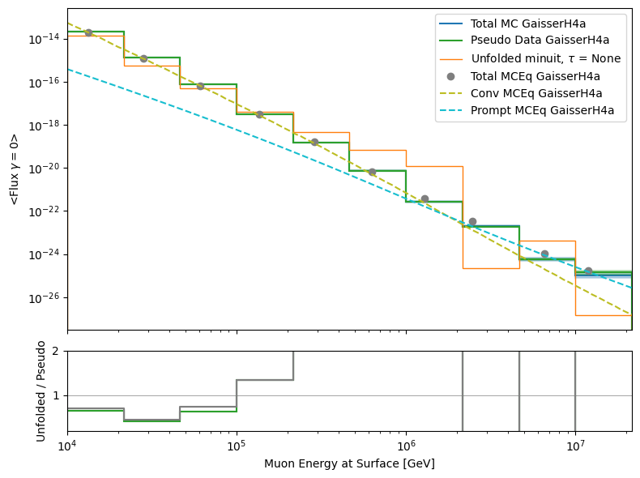
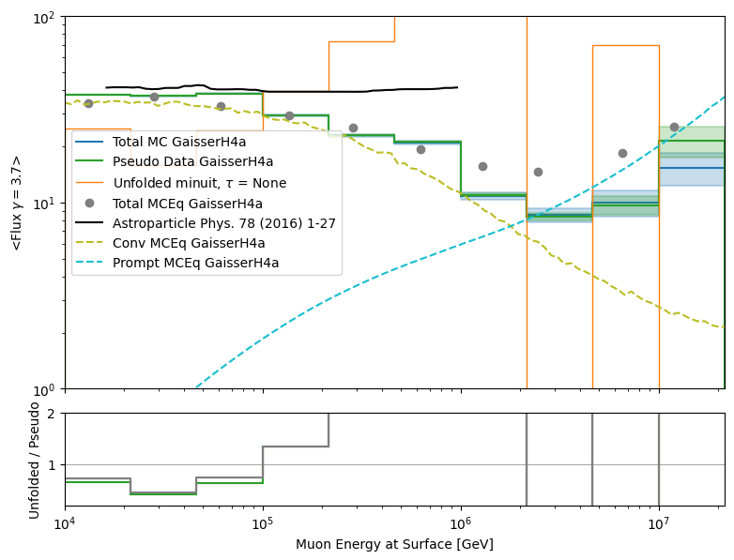
Flat

Slide 18
Test several pseudo samples

Slide 19
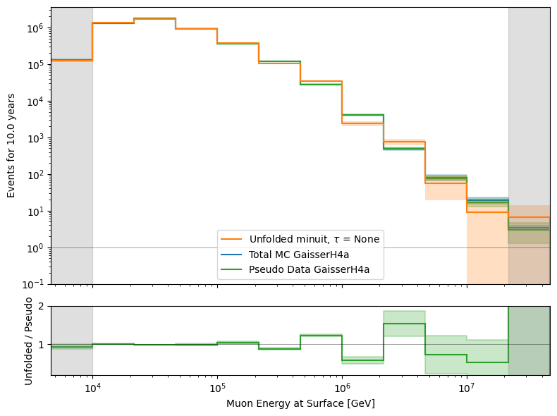
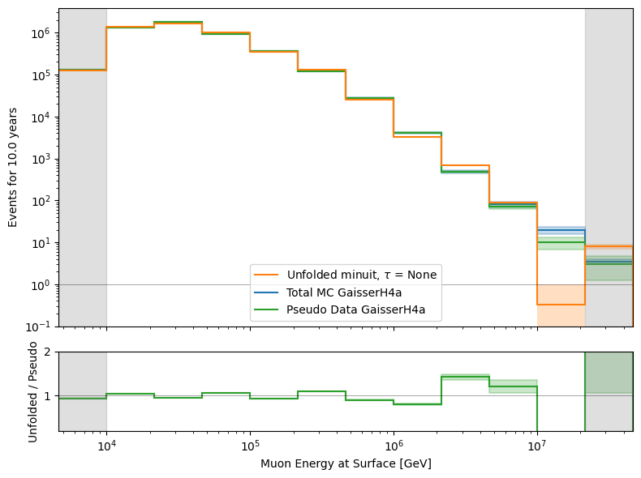
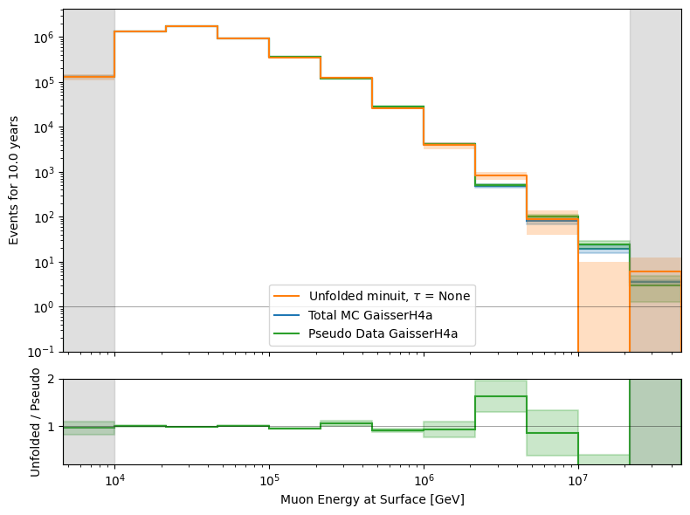
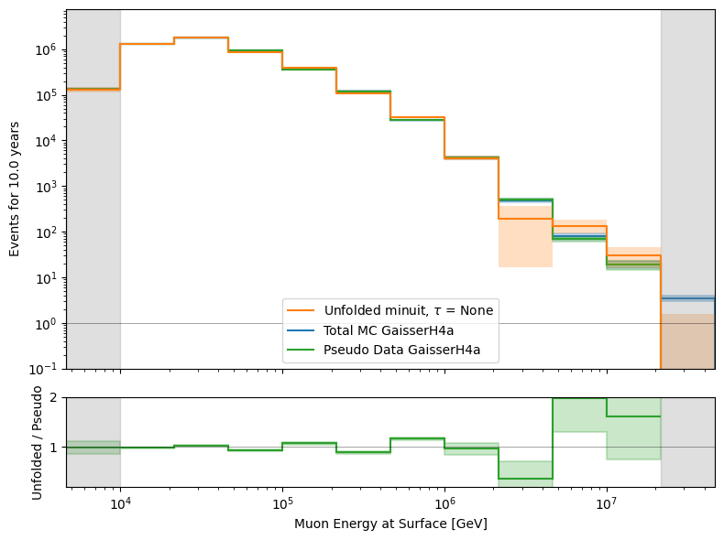
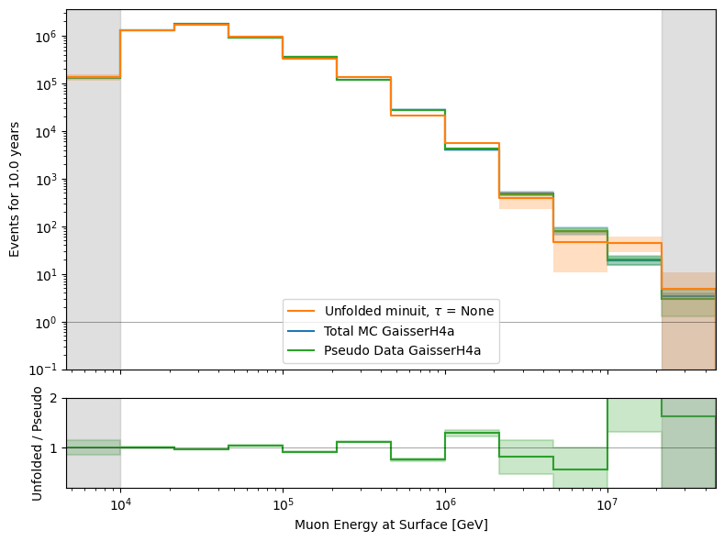
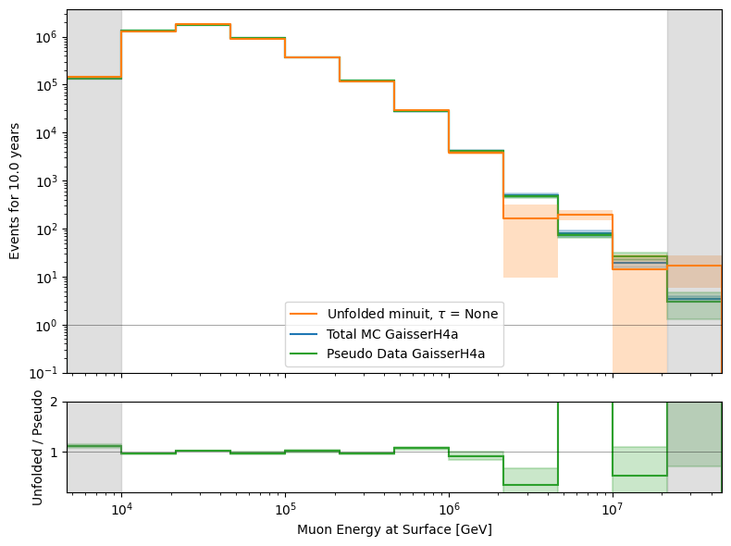
Unfold event rate

